Slide 1
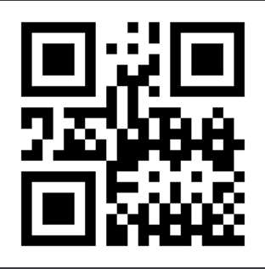
Title
Add Author Names
Add Department
Introduction
Results
Introduces your topic and communicates the relevance and significance in the field of study or community.
Provide context to viewer by summarizing and citing relevant research to date and how your research fits in with current knowledge.
Explain how your research addresses gaps in knowledge within existing research or what is not yet known.
Information in this section is taken from your literature review. Include most significant and relevant information.
Average size for subheading type is 36- to 44-point (Arial Bold) with main text around 24- to 34-point (Arial Regular).
This is the main takeaway from your research. It should be simplified to one or two sentences.
Communicates what you found out during your research.
• Briefly share your data analysis.
• Use figures, tables and other visual aids to communicate your findings.
• Use captions to describe graphics.
• Average size for caption type is
18- to 22-point (Arial Regular).
Research Goal
Acknowledgements
Provides a clear statement about the research problem(s) your research aims to solve or a statement about the issue you investigated.
Brief and succinct; one sentence.
Provides a list of people or organizations that contributed to your project.
Thank your funding sources and faculty mentor(s).
Include research centers or organizations where research was conducted.
Include others who contributed significantly but were not part of your author list.
Methods/Process/Tools
References
Tells the viewer what research strategy was used and how the research was completed.
Briefly describe what you did to address your research question(s).
Use visual aids to summarize information which might include figures, tables, photos or diagrams.
Explain any strengths and limitations of your methodology.
Lists of sources referenced in your poster.
Check with your faculty mentor regarding citation requirements for your discipline .
Optional QR code to scan to download a digital copy of your poster and/or additional information or references. QR Code Generator offers a free version. Remember to test the code before printing.

